Slide 1



CAPSTONE PROJECT
RBI Liabilities and Assets Analysis Dashboard
Presented By
Student Name: p . DIVYA
College Name: INSTITUTE OF COST ACCOUNTANTS OF INDIA & CAREER DEGREE COLLEGE
Department: CMA INTER & B.COM (COMPUTERS)
Email ID: divyapallabothula02@gmail.com

Slide 2
OUTLINE:
Problem Statement (Should not include solution)
Proposed System/Solution
System Development Approach (Technology Used)
Algorithm & Deployment
Result (Output Image)
Conclusion
Future Scope
References

Slide 3
PROBLEM STATEMENT:
The Reserve Bank of India manages large amounts of financial data related to assets, liabilities, deposits, and loans. Analyzing this data manually is difficult and time-consuming.
There is a need for an interactive system that can
Analyze RBI financial data across different years
Compare assets and liabilities trends
Identify deposit distribution and loan categories
Provide quick insights for financial decision making
Without visualization tools, it becomes difficult to identify patterns, trends, and financial changes over time.

Slide 4
PROPOSED SOLUTION:
To solve this problem, a Power BI dashboard is developed to analyze RBI financial data efficiently.
The proposed system:
Collects and cleans RBI financial datasets
Uses Power BI to create interactive dashboards
Visualizes assets, liabilities, deposits, and loans
Allows filtering by year and asset categories
Provides insights using charts, tables, and KPI cards
This system helps users easily understand financial trends and make data-driven decisions.

Slide 5
SYSTEM APPROACH:
Tools Used
Microsoft Excel – Data cleaning and preprocessing
Power BI – Data visualization and dashboard creation
Techniques Used
Data Transformation using Power Query
Data Modeling
DAX Measures for calculations
Interactive Visualizations
Key Visualizations Used
KPI Cards
Bar Charts
Donut Charts
Tables Stacked Charts
Slicers for filtering

Slide 6
EXECUTION FRAMEWORK:
Data Preparation
RBI financial data is imported into Power BI.
Data cleaning is performed using Power Query.
Missing values and inconsistencies are handled.
Data Modeling
Relationships between datasets are created.
Measures such as Average Total Assets , Average Total Deposits and Average Total Liabilities are calculated using DAX.
Dashboard Development
Visualizations are created to represent:
Asset distribution by category
Liabilities breakdown
Deposits analysis
Loans and advances by category
Year-wise financial comparison
Deployment
The final dashboard is published and can be shared for analysis and reporting.

Slide 7
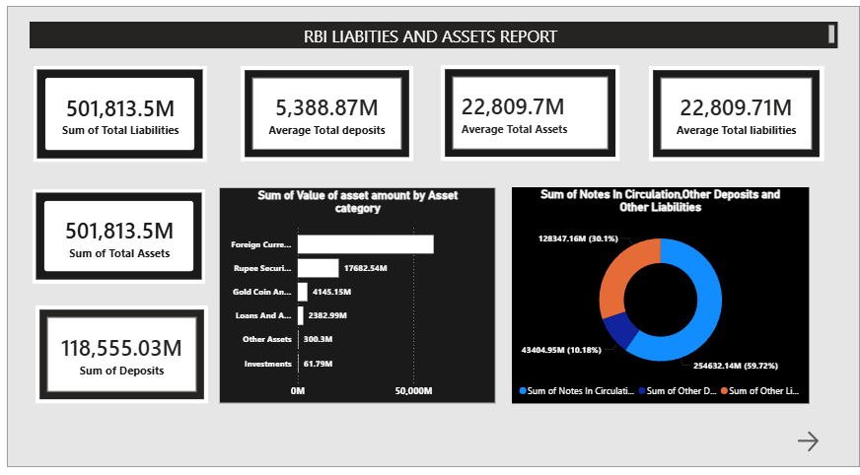
Screen Shots 1:

Slide 8
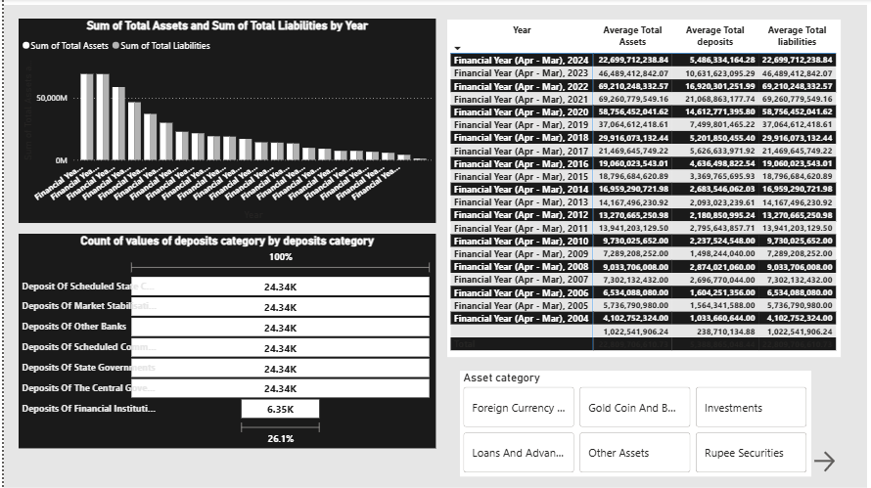
Screen shot 2:

Slide 9
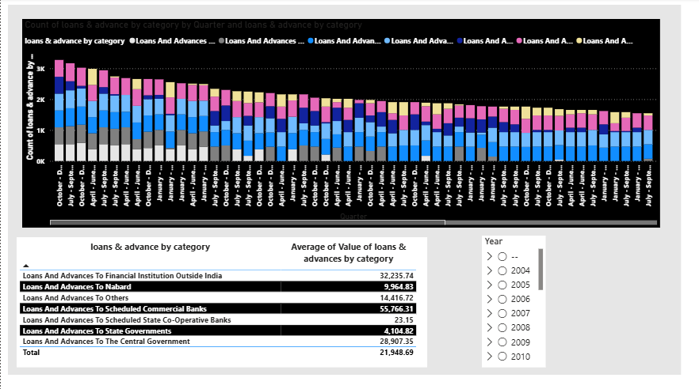
Screen shot 3:

Slide 10
RESULT:
The developed dashboard provides clear insights into RBI financial data.
Key results include:
Sum of Total Liabilities – 501,813.5M
Average Total Deposits – 5,388.87M
Average Total Assets – 22,809.7M
Average Total Liabilities – 22,809.71M
Sum of Total Assets – 501,813.5M
Sum of Deposits – 118,555.03M
Insights:
Foreign currency assets form the largest asset category.
Notes in circulation contribute the largest share of liabilities.
Loans and advances vary across different categories and quarters.
Financial trends can be analyzed year-wise

Slide 11
CONCLUSION:
The RBI Assets and Liabilities Dashboard successfully visualizes complex financial data using Power BI.
The system helps:
Understand financial trends over multiple years
Analyze deposits, assets, and liabilities easily
Identify major contributors to RBI financial structure
The dashboard improves data analysis efficiency and supports better financial insights.

Slide 12
FUTURE SCOPE:
The project can be further improved by:
Integrating real-time RBI financial data
Adding predictive analytics for future financial trends
Including more advanced financial indicators
Deploying the dashboard as a web-based analytics platform
Applying machine learning models for financial forecasting

Slide 13
REFERENCES:
RBI Official Financial Reports
Microsoft Power BI Documentation
Microsoft Learn – Data Analytics Modules
AICTE – Microsoft Elevate Internship Learning Resources
GitHub Link: https://github.com/divyapallabothula02-alt/MICROSOFT-ELEVATE-POWERBI-DASHBOSRD

Slide 14
Thank You

